Slide 1
IoT and Cyber Security
Preventing ‘maximum overdrive’

Slide 2
Agenda
Who am I?
Secarma’s IoT Capabilities
Hollywood vs Reality
What is the IoT Checklist?
Words on risks
Six Security Fundamentals
High-Level advice
What are you up against?

Slide 3
Who am I?
My name is Paul Ritchie.
I am the leader of Secarma in Scotland.
I have been a Penetration Tester since 2005 (Scarily 12 years).
Undergraduate and MSc level training as a Software Engineer
Hardware “newbie”
Online I can be found as “CornerPirate”:
https://twitter.com/cornerpirate
https://github.com/cornerpirate
https://cornerpirate.com/

Slide 4
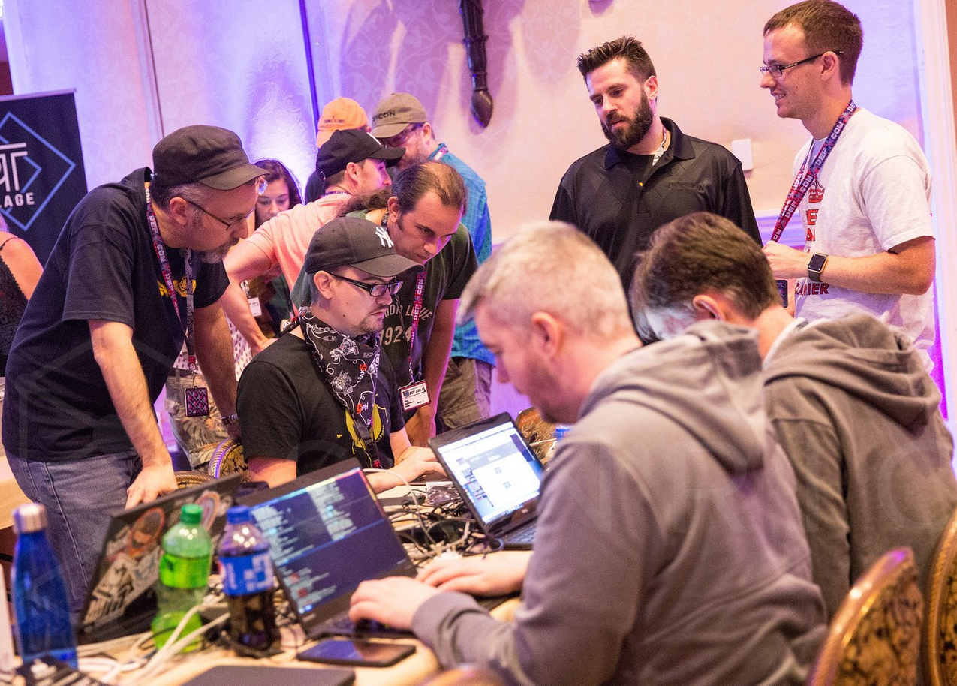
Secarma’s IoT Capabilities
Blog Posts
https://www.secarma.co.uk/secarma-scores-big-defcon-global-hacking-convention/
https://www.secarma.co.uk/labs
DEFCON 25 in Las Vegas (35 thousand hacker’s attending)
SOHOpelesslyBroken Capture The Flag
Second Winningest!
Same points as first
Beaten on time
SOHOpelesslyBroken 0-Day
Officially: we did well.
Unofficially: we did very well.

Slide 5

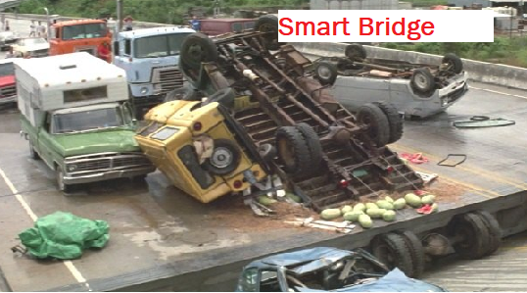
IoT Security: Hollywood
Full Film available for free on Archive.org
https://archive.org/details/MaximumOverdrive19863gp

Slide 6


IoT Security: Hollywood
TL; DR
If our machines attack us, it would be very bad.
The worry is that bad security allows similar things to happen.

Slide 7
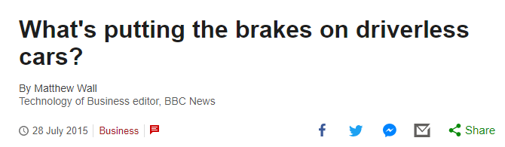
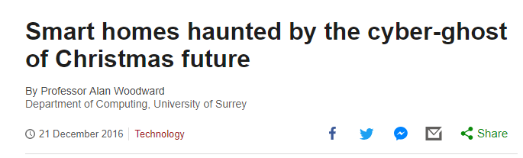
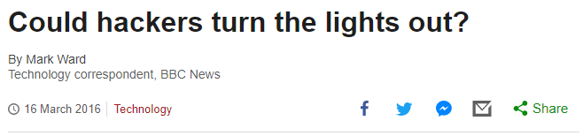

IoT Security: Reality Check

Slide 8

Why?
FOCUS (come on Andy!)
Bigger Picture
Features
User experience
Education
Someone else will do it?

Slide 9
What is the IoT Checklist?
A work in progress!
A starting point when considering security of IoT Devices.
Analysis of IoT security articles:
Boiling them down I found trivial and recurring root causes.
Free advice that is intended to help.
Where to get it?
Blog Post
https://www.secarma.co.uk/internet-of-things-iot-security-checklist/
Secarma Labs - GitHub
https://github.com/SecarmaLabs/IoTChecklist

Slide 10
Risky Business
Consumer Risks
Data Protection Breaches (and fines) for vendors [Cayla]
Identity theft or embarrassment for consumer.
Collateral Risks to Connected Network
A device which is connected to a Wi-Fi/Ethernet becomes a node.
Compromising that device gives access to those networks.
Collateral Risks
Compromised devices used in DDoS attacks [Mirai Botnet]
The impact here is to unknown third parties
Not your users or yourself directly.
Reputational Risks
Failure to provide security affects Reputation of Vendor and Product.

Slide 11
Categories of Risk
Technical Flaws
The IoT CheckList helps to guard against these.
We will show the six fundamentals later.
Privacy/Legal Flaws
If the device handles user data or the sensor can be used to breach privacy.
Then special consideration should be given to the legal aspect.
Identify the potential of privacy breaches.
Implement technical controls to guard against them when possible.
CONSULT legal advice to determine where liability for breaches will lie: will they be on the end user or you as the provider?

Slide 12
IoT CheckList Process
Device Decomposition
Review Each Interface
Find a Security Partner
Break the product into a list of its interfaces. Identify every hardware and software interface which can be interacted with and create a matrix to capture each individual element
For each item in your matrix conduct a risk analysis. Update your matrix with technical/privacy legal concerns.
Get 3rd party verification

Slide 13
Security Principals
The Six Security Fundamentals of the checklist:
Default/Weak Passwords
Missing Security Updates
Insecure Web Administration
Use of Insecure protocols
Check for known configuration weaknesses
Insecure Data Storage

Slide 14
High-Level Advice [1/2]
Secure by Default – Ask yourself if configurations are secure out of the box, or if the user must do something to enable protection? As cybersecurity has evolved over the last decade, the strategy of securing out-of-the-box is preferred to relying on users. General tips would include disabling features until they are enabled and generating random per-device passwords, for example.
Provide an Update Function – Even the best engineered solution will eventually have some functional or security bug that would require an update. To support this, design a robust update mechanism which can protect users long term.

Slide 15
High-Level Advice [2/2]
Assume the source code is visible – Make sure that there are no hard-coded secrets on the device which have a security impact for all devices. Attackers will have physical access to your products over many years. These are ideal conditions from which to reverse engineer. If you need hard-coded secrets then design them to be unique for each device. So that finding the default admin password within firmware will not expose all other devices. Additionally, be aware that the source for any admin interfaces is equally exposed.
Plan for Decommissioning – IoT products are consumer electronics in most cases. Give users an easy way to remove their data from the device so that they can sell it on or dispose of it securely.

Slide 16
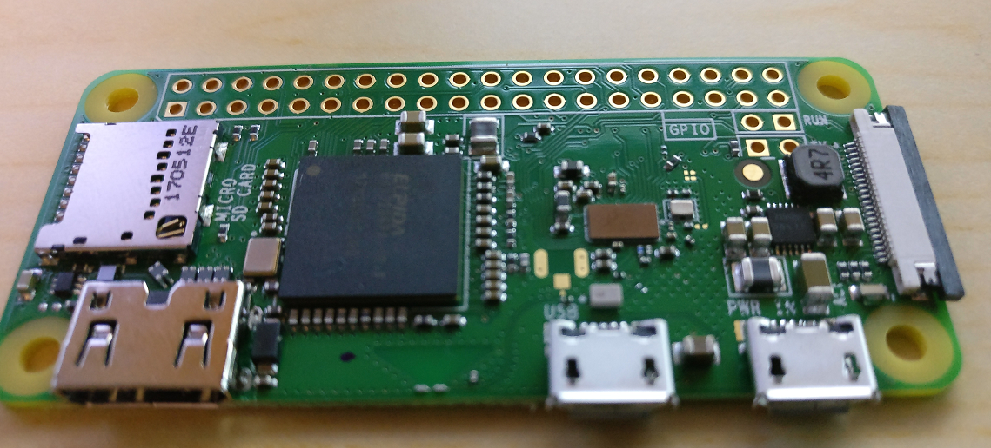
What are you up against?
Bluetooth, Wireless, USB
Raspberry Pi (this is our Zero W) - ~£30

Slide 17
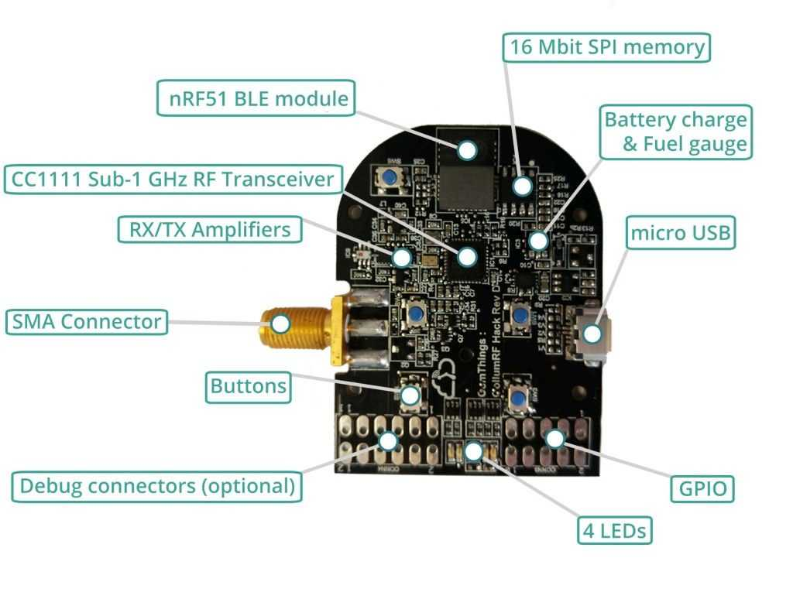
What are you up against?
PandwaRF
Pocket-sized, portable RF analysis tool
Sub-1 GHz range.
Capture
Analysis; and
re-transmission of RF ~ £190
Alternatives:
RfCAT ~ £66

Slide 18
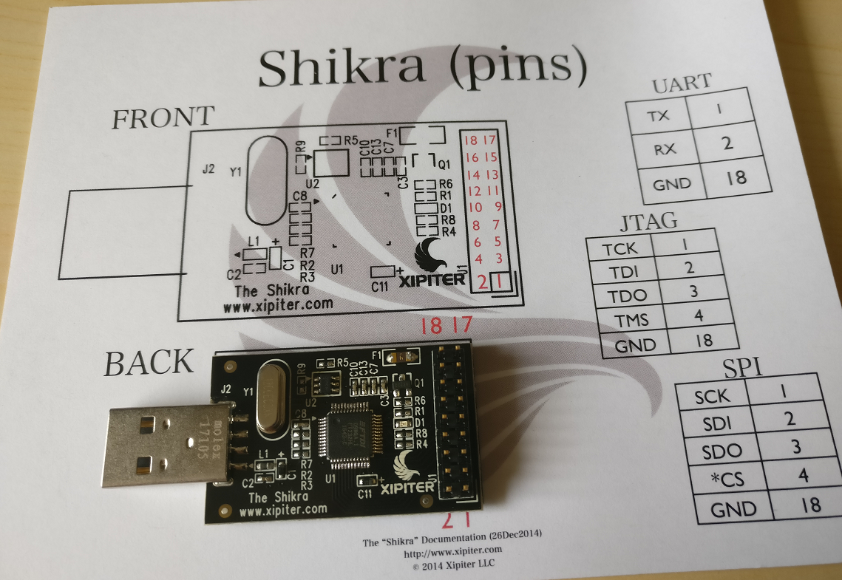
What are you up against?
Dumping Firmware
JTAG
UART
SPI
I2C
GPIO
~ £35

Slide 19
Questions?
No gifs were harmed in the making of this.

